Slide 1
IELTS
GENERAL WRITING TASK 1

Slide 2
THANK YOU LETTER
1. Dear Sir/Madam, (or name if given)
2. The purpose of the letter: explanation, reason for writing
  I am writing this letter to thank you for all the support and guidance that you provided me throughout my internship period at your company.
  Thanks so much for your kind letter
  I am writing about topic. And I would like to express my deepest thanks to you.
  How are you? I hope this letter finds you well. Although it’s such a short time since we last saw each other, it feels much longer. (Thư Informal)

Slide 3
THANK YOU LETTER
3. Say how thankful you are (Last sentence of the detail body)
If you had not decided to help me, the situation could have been worse.
I am so grateful to you for your kind help and generosity.
I cannot express enough how thankful I am to you.
Without your help/ suggestion, I would (not) have + V3/ed
Thanks to your support/ help, I am able to ….
Extra wheel

Slide 4
THANK YOU LETTER
5 Đưa ra sự trả ơn
I regret that I could not thank you enough. Please accept my invitation to visit our home at your convenience and allow my family to thank you properly. I have recovered quickly and the thanks go to you. Please visit us with your family and let our brief encounter becomes an opportunity to know you more.

Slide 5
THANK YOU LETTER
6. Signing off
Once again, I thank you very much for your help/ support.
7. Formal ending, name, signature
  I look forward to hearing from you!
  I look forward to receiving a prompt reply!
  Yours sincerely, ... (you know the name of person you are writing to)
  Yours faithfully, ... (you don't know the name!)

Slide 6
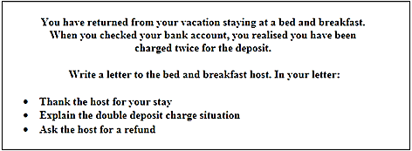
Dear Sir/Madam,
I am writing in reference to my vacation in your bed and breakfast. I would like to express my deepest thanks to your service.
Giải thích … I am so grateful to you for your kind help and generous care.
Giải thích 2.
I wonder if you could possibly tell/send me …
Once again, I thank you very much for your support
I look forward to receiving a prompt reply!
Yours sincerely,
Nhan

Slide 7
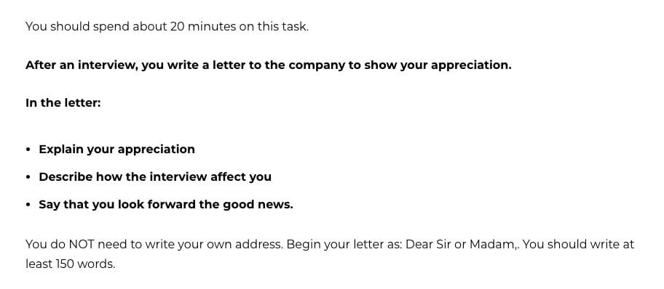
Dear Sir/ Madam,
I am writing in reference to your interview with me two weeks ago. And I would like to express my deepest thanks to you.
To explain in more details, giải thích chi tiết/ kể lại chi tiết. I cannot express enough how thankful I am to you.
After the interview, giải thích hiệu quả của buổi phỏng vấn
Đưa ra mong tin tốt như nào.
I regret that I could not thank you enough. Đưa sự trả ơn.
Once again, I thank you very much for your help
I look forward to receiving a prompt reply!
Yours faithfully,

